Slide 1
Fast Fourier Transform for speeding up the multiplication of polynomials
an Algorithm Visualization
Alexandru Cioaca

Slide 2
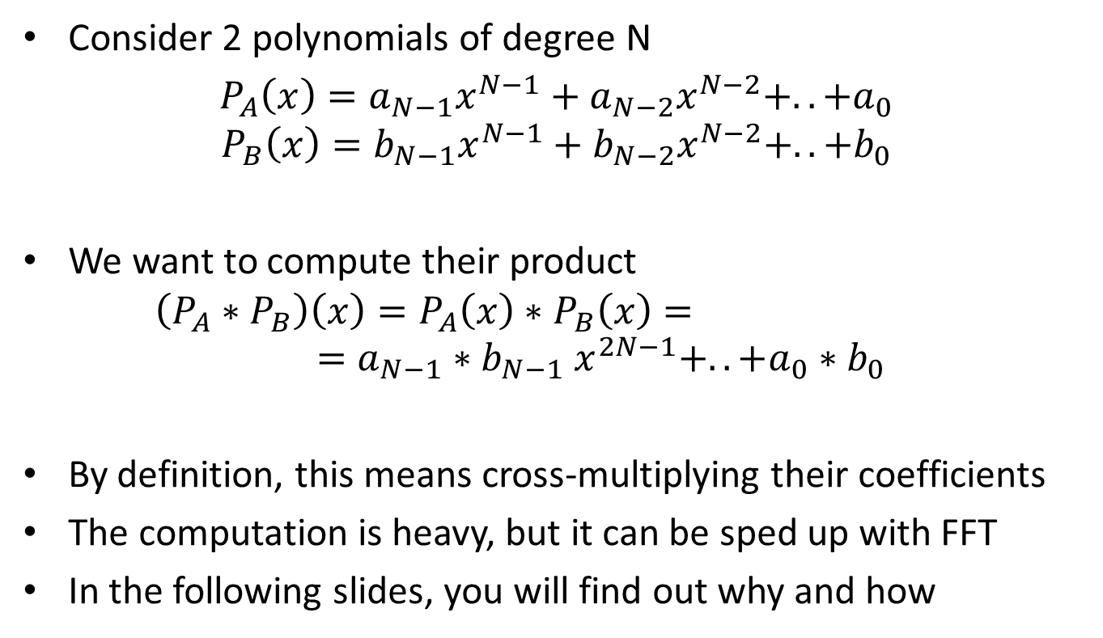
Defining the problem
Consider 2 polynomials of degree N
$P_{A}\left(x\right)={a_{N−1}x}^{N−1}+{a_{N−2}x}^{N−2}+..+a_{0}$
$$P_{B}\left(x\right)={b_{N−1}x}^{N−1}+{b_{N−2}x}^{N−2}+..+b_{0}$$
We want to compute their product
$$\left(P_{A}∗P_{B}\right)\left(x\right)=P_{A}\left(x\right)∗P_{B}\left(x\right)=$$
$$={a_{N−1}∗b_{N−1} x}^{2N−1}+..+a_{0}∗b_{0}$$
By definition, this means cross-multiplying their coefficients
The computation is heavy, but it can be sped up with FFT
In the following slides, you will find out why and how

Slide 3
The explicit form of a polynomial is given by the list of coefficients and we can use it to compute the polynomial’s values at any point (for any variable)
This operation is called Evaluation
In reverse, if we have the values of a polynomial of order N at at least N distinct points, we can determine its coefficients
This operation is called Interpolation

Slide 4
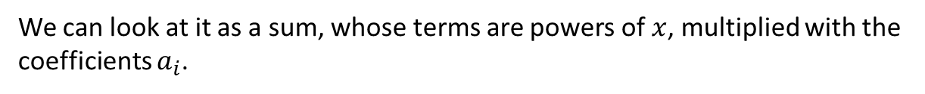
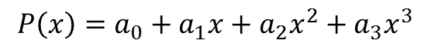
Consider the following polynomial
$$P\left(x\right)=a_{0}+a_{1}x+a_{2}x^{2}+a_{3}x^{3}$$
We can look at it as a sum, whose terms are powers of $x$, multiplied with the coefficients $a_{i}$.

Slide 5

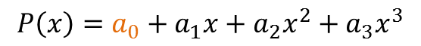
$$P\left(x\right)=a_{0}+a_{1}x+a_{2}x^{2}+a_{3}x^{3}$$
First we have the constant component, represented by $a_{0}$

Slide 6
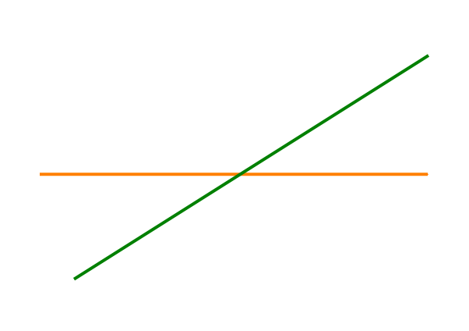
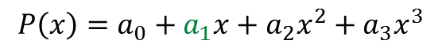
$$P\left(x\right)=a_{0}+a_{1}x+a_{2}x^{2}+a_{3}x^{3}$$
Then, a linear component represented by a line of slope $a_{1}$

Slide 7
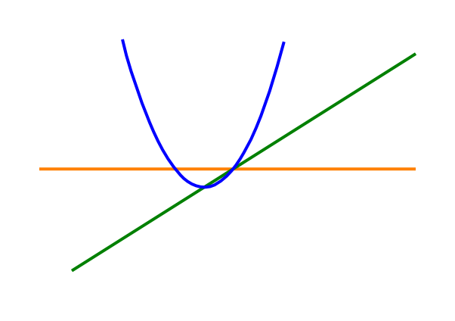
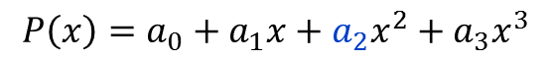
$$P\left(x\right)=a_{0}+a_{1}x+a_{2}x^{2}+a_{3}x^{3}$$
Next, the root of $x$ multiplied with $a_{1}$

Slide 8
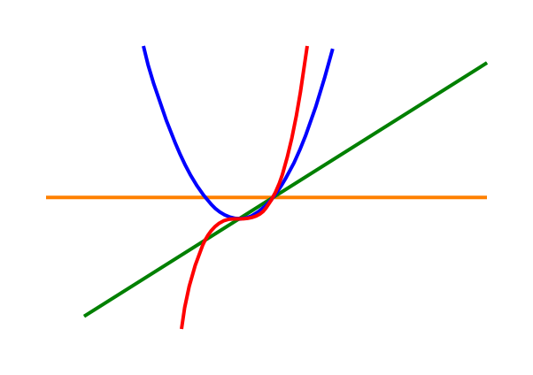
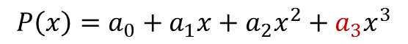
$$P\left(x\right)=a_{0}+a_{1}x+a_{2}x^{2}+a_{3}x^{3}$$
Last, we have a third-order component, with the coefficient $a_{3}$

Slide 9
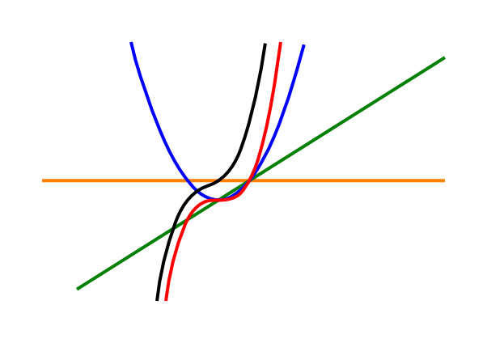
$$P\left(x\right)=a_{0}+a_{1}x+a_{2}x^{2}+a_{3}x^{3}$$
Adding these 4 components gives us our polynomial (in black)

Slide 10
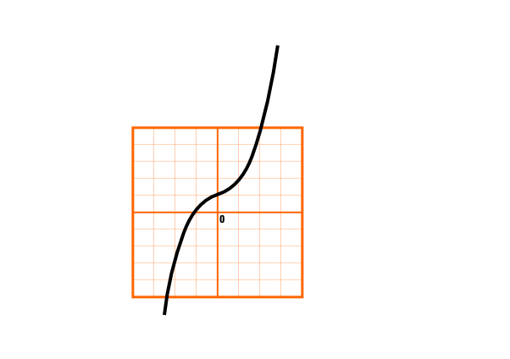
Let’s draw a cartesian grid for our polynomial

Slide 11

Imagine we choose (or we are given) some points on the $x$ axis.

Slide 12

Imagine we choose (or we are given) some points on the $x$ axis.

Slide 13

Imagine we choose (or we are given) some points on the $x$ axis.

Slide 14
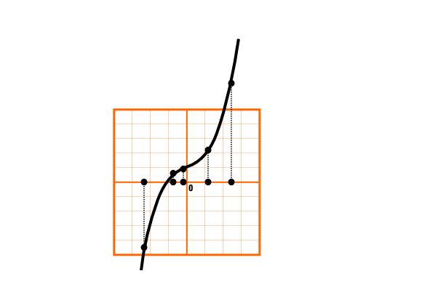
We can evaluate our polynomial at these points. This is Evaluation.

Slide 15
Now imagine the reverse operation for our polynomial.
What if we don’t have its explicit form, so we can’t evaluate it?

Slide 16
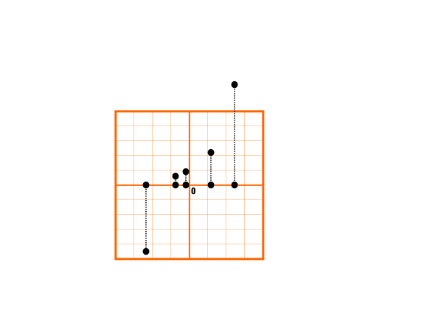
Instead, we only have its value at certain points.

Slide 17

From these values, the polynomial can be reconstructed approximately.
This approximation is better for more and more values.

Slide 18
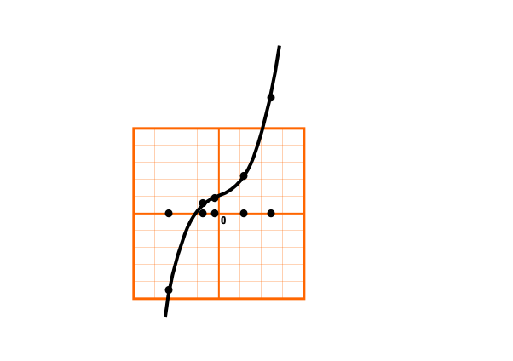
This is Interpolation.

Slide 19
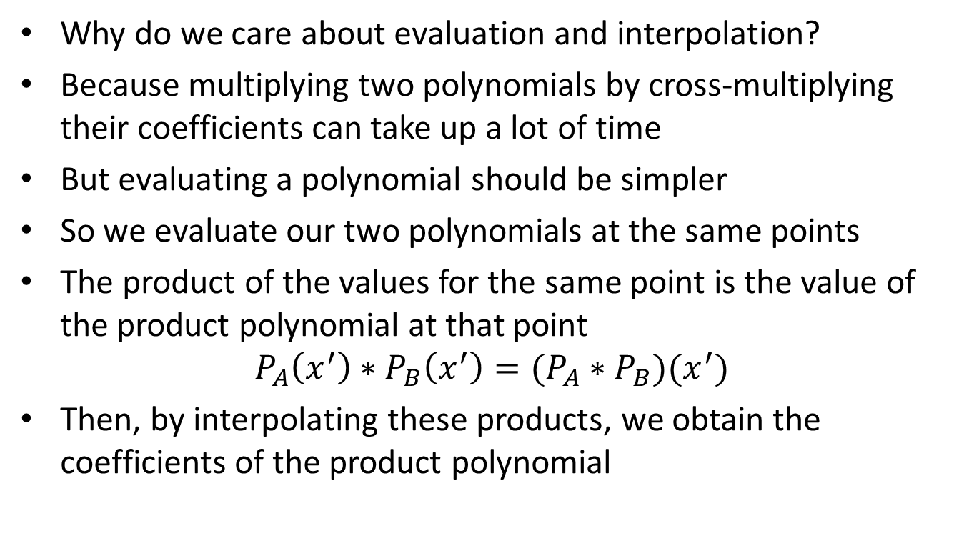
Why do we care about evaluation and interpolation?
Because multiplying two polynomials by cross-multiplying their coefficients can take up a lot of time
But evaluating a polynomial should be simpler
So we evaluate our two polynomials at the same points
The product of the values for the same point is the value of the product polynomial at that point
$$P_{A}\left(x^{′}\right)∗P_{B}\left(x^{′}\right)=(P_{A}∗P_{B})(x^{′})$$
Then, by interpolating these products, we obtain the coefficients of the product polynomial

Slide 20
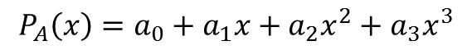
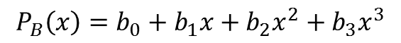
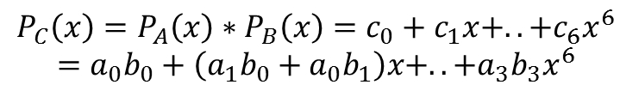
Consider the following two polynomials
$$P_{A}\left(x\right)=a_{0}+a_{1}x+a_{2}x^{2}+a_{3}x^{3}$$
$$P_{B}\left(x\right)=b_{0}+b_{1}x+b_{2}x^{2}+b_{3}x^{3}$$
Their product is
$$P_{C}\left(x\right)=P_{A}\left(x\right)∗P_{B}\left(x\right)=c_{0}+c_{1}x+..+c_{6}x^{6}$$
$$=a_{0}b_{0}+\left(a_{1}b_{0}+a_{0}b_{1}\right)x+..+a_{3}b_{3}x^{6}$$

Slide 21
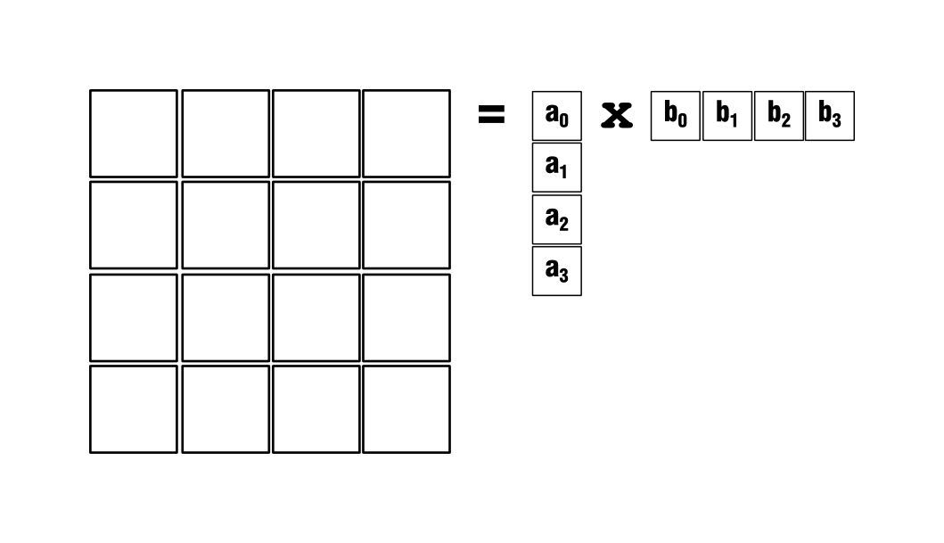
The coefficients of the product polynomial can be computed from the following outer-product

Slide 22
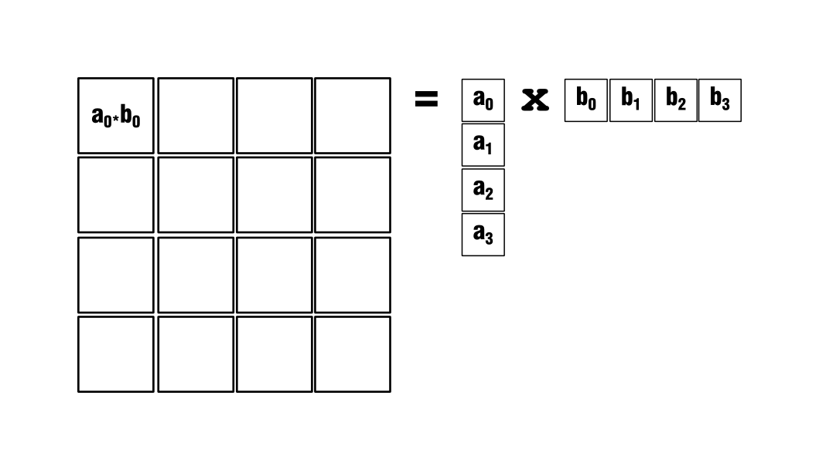
This means computing the product of each pair of coefficients

Slide 23
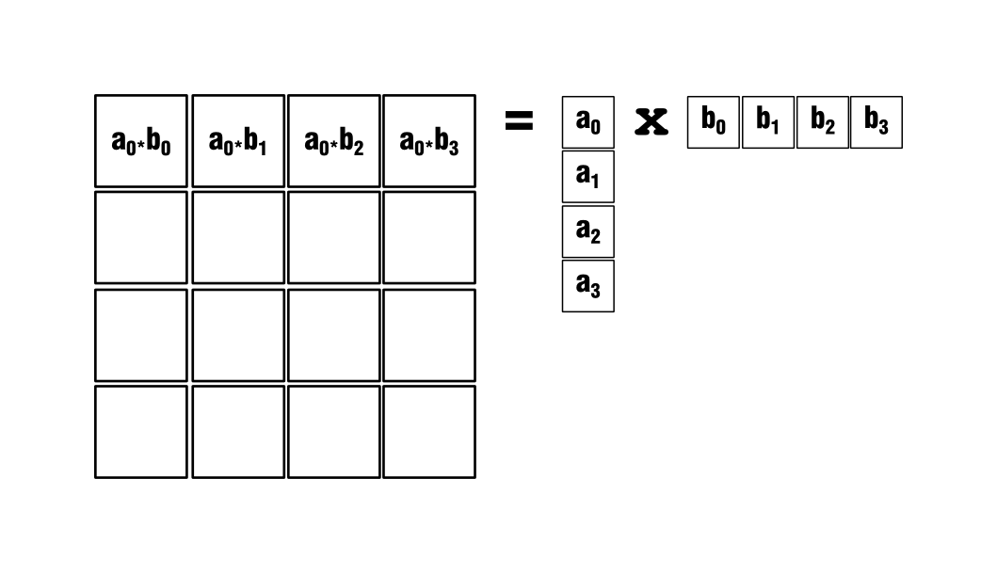

Slide 24
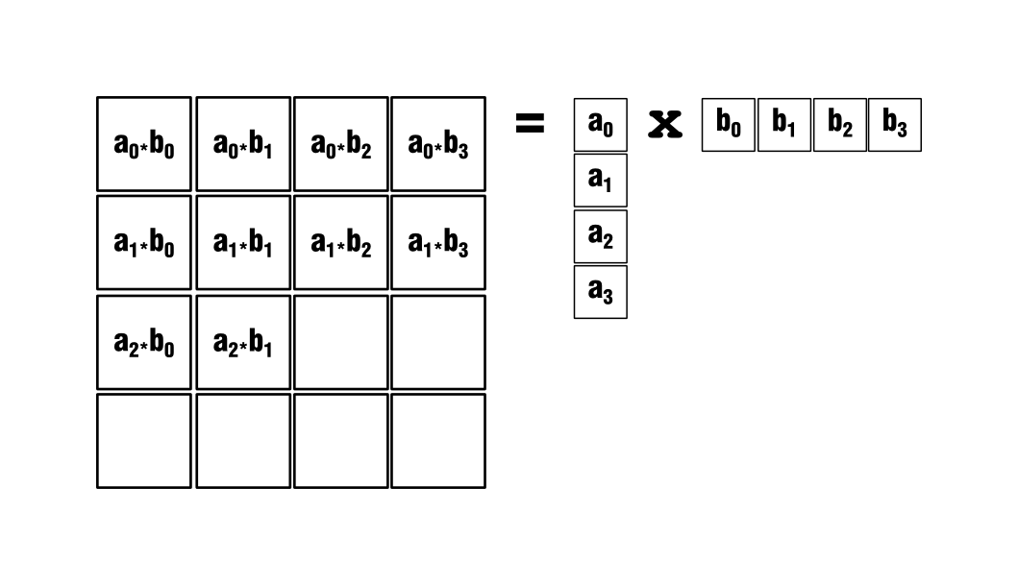

Slide 25
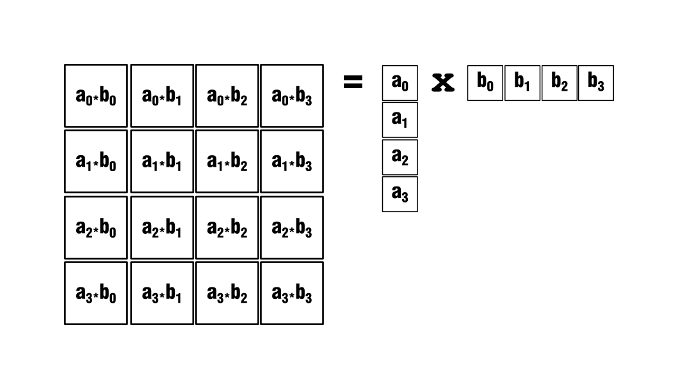

Slide 26
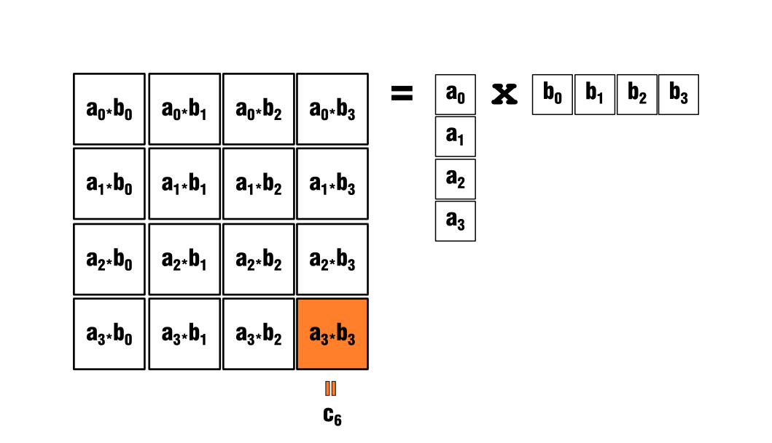
And then adding the terms

Slide 27
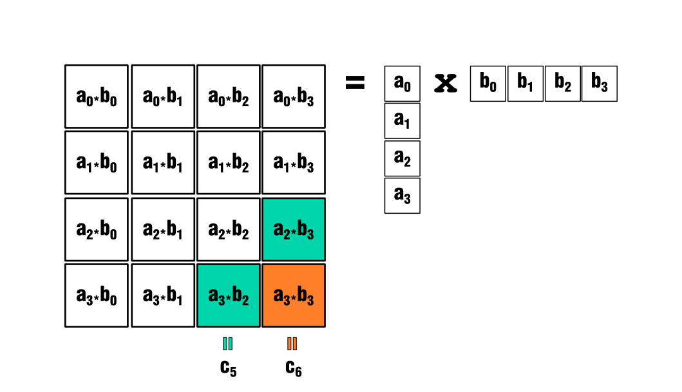
And then adding the terms

Slide 28
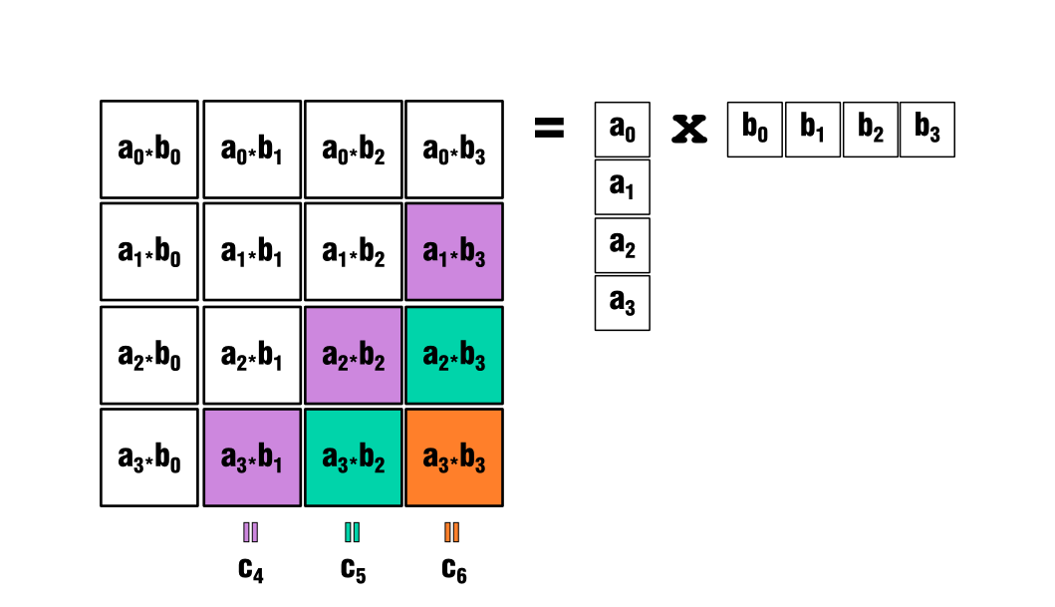
And then adding the terms

Slide 29
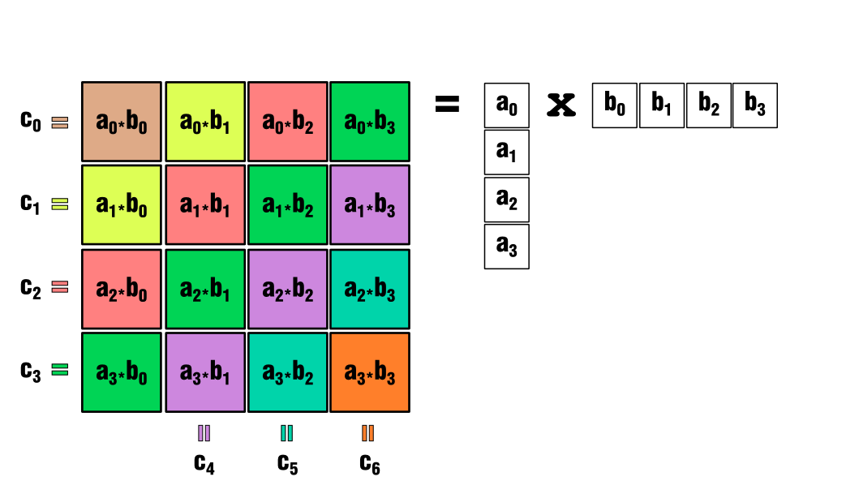
And then adding the terms

Slide 30
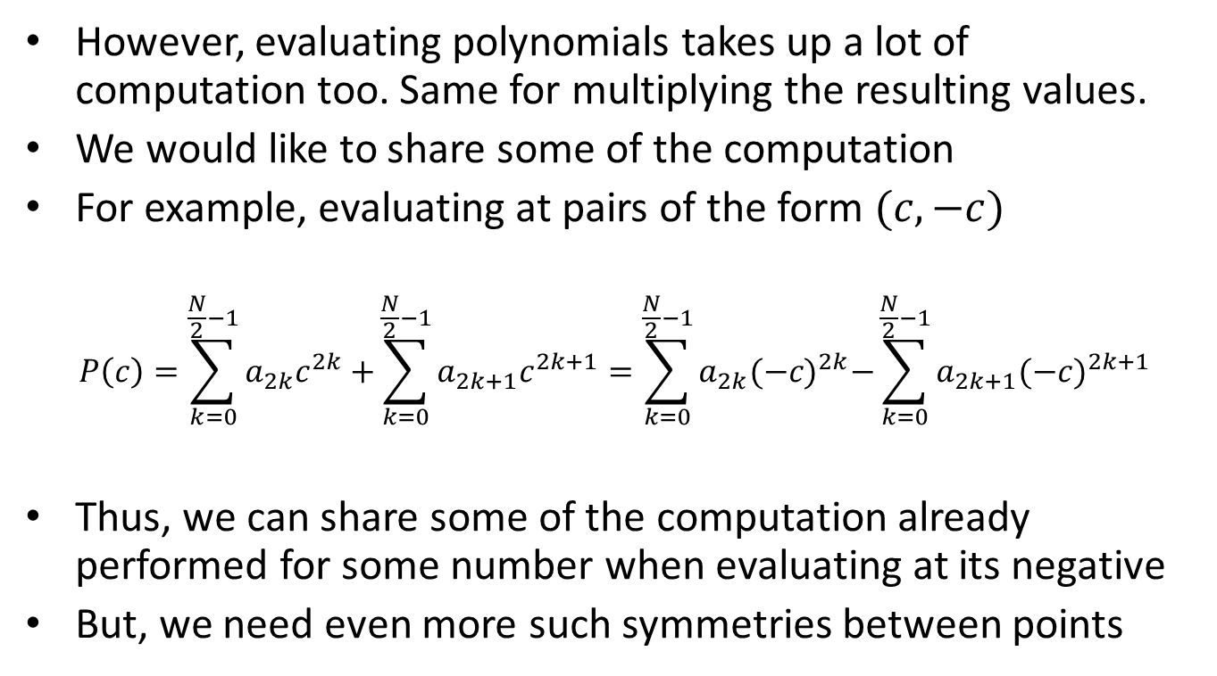
However, evaluating polynomials takes up a lot of computation too. Same for multiplying the resulting values.
We would like to share some of the computation
For example, evaluating at pairs of the form $(c,−c)$
$$P\left(c\right)=\sum_{k=0}^{\frac{N}{2}−1}{a_{2k}c^{2k}+}\sum_{k=0}^{\frac{N}{2}−1}{a_{2k+1}c^{2k+1}}=\sum_{k=0}^{\frac{N}{2}−1}{a_{2k}{(−c)}^{2k}−}\sum_{k=0}^{\frac{N}{2}−1}{a_{2k+1}(−{c)}^{2k+1}}$$
Thus, we can share some of the computation already performed for some number when evaluating at its negative
But, we need even more such symmetries between points

Slide 31
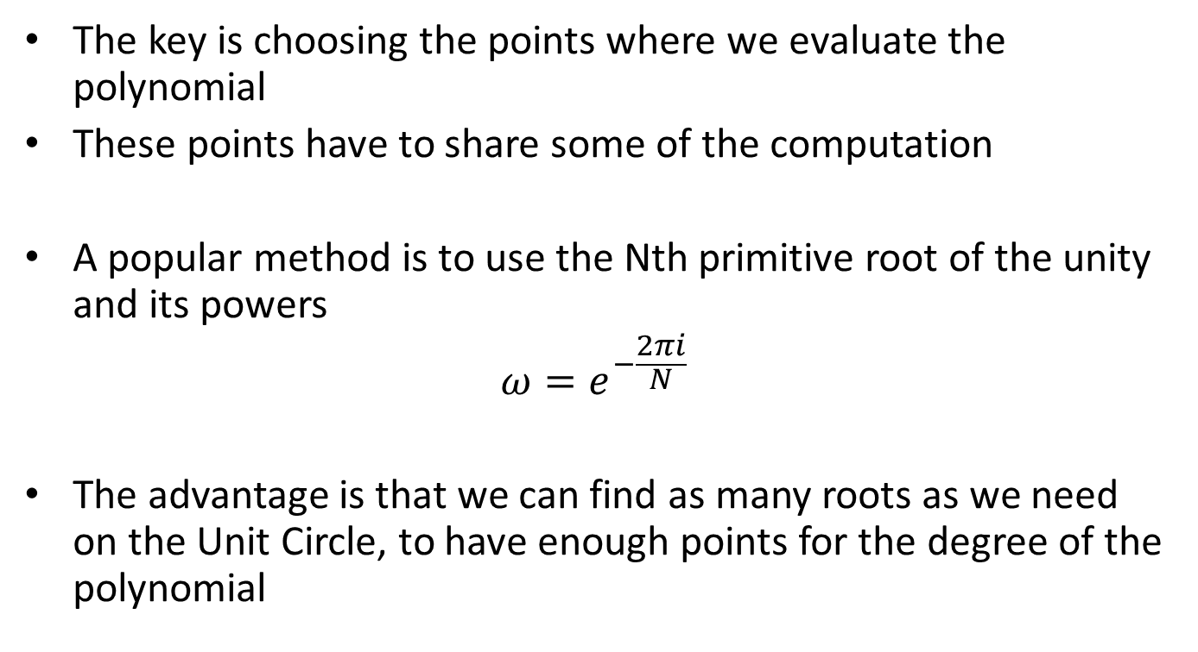
The key is choosing the points where we evaluate the polynomial
These points have to share some of the computation
A popular method is to use the Nth primitive root of the unity and its powers
$$ω=e^{−\frac{2πi}{N}}$$
The advantage is that we can find as many roots as we need on the Unit Circle, to have enough points for the degree of the polynomial

Slide 32
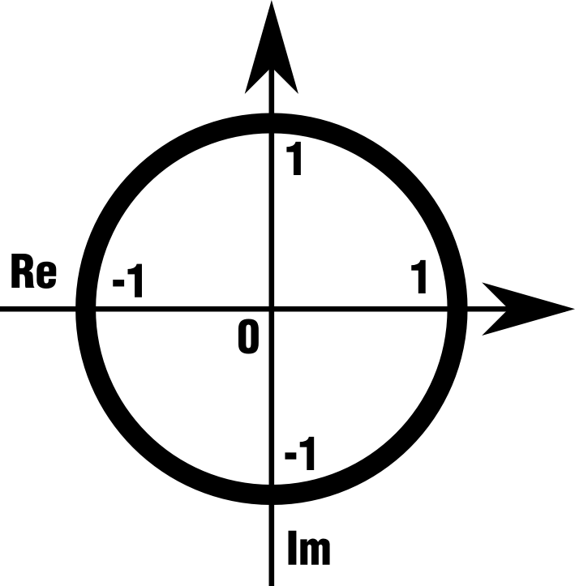
Look at the symmetry of these roots on the Unit Circle

Slide 33
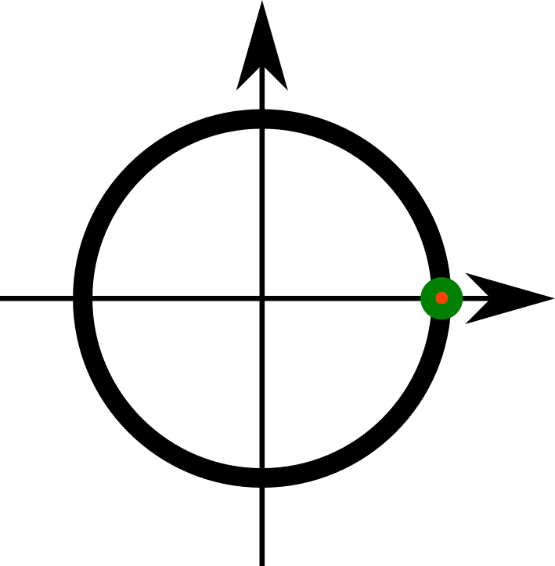
N=1

Slide 34
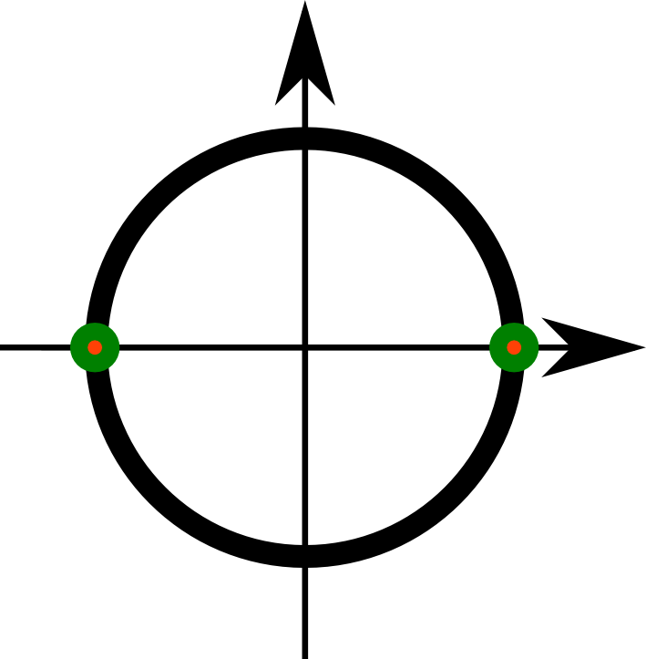
N=2

Slide 35
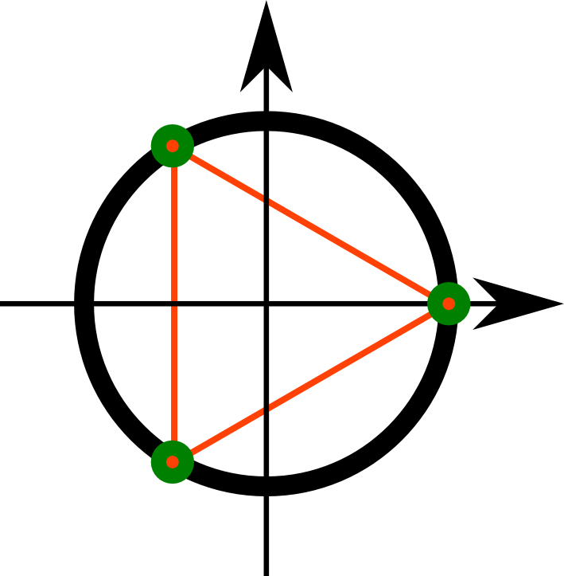
N=3

Slide 36
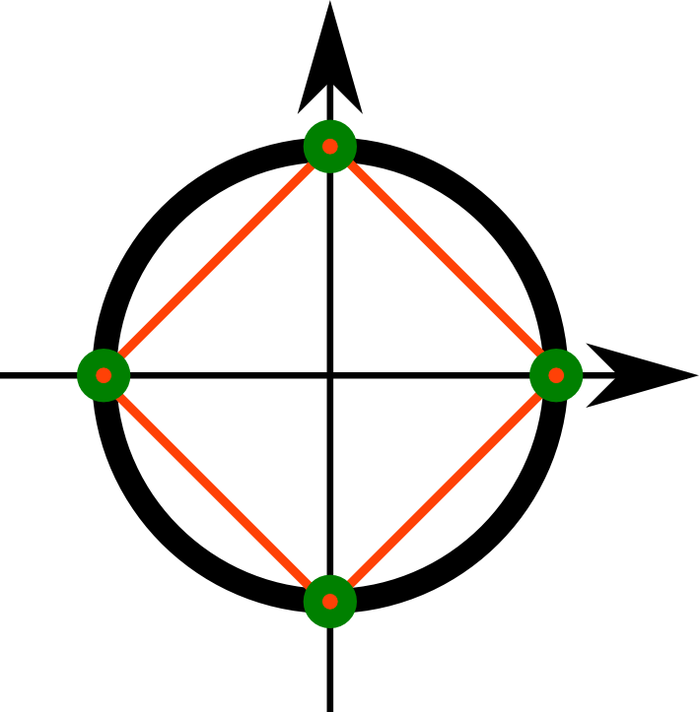
N=4

Slide 37
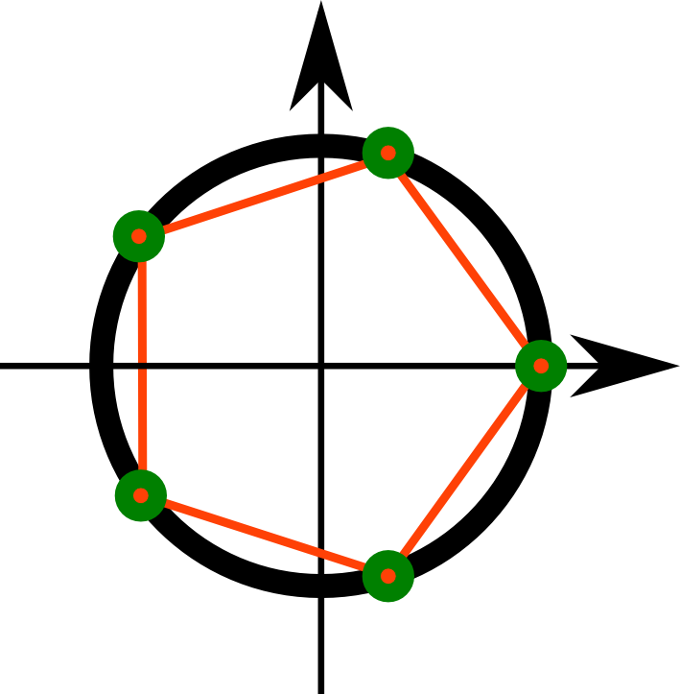
N=5

Slide 38
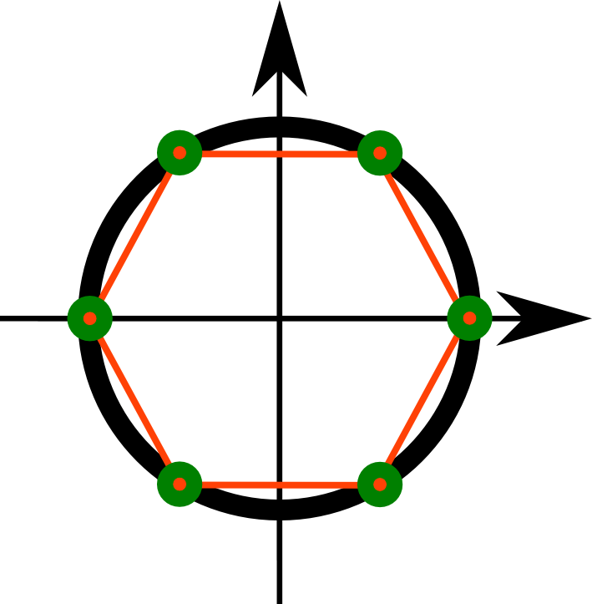
N=6

Slide 39
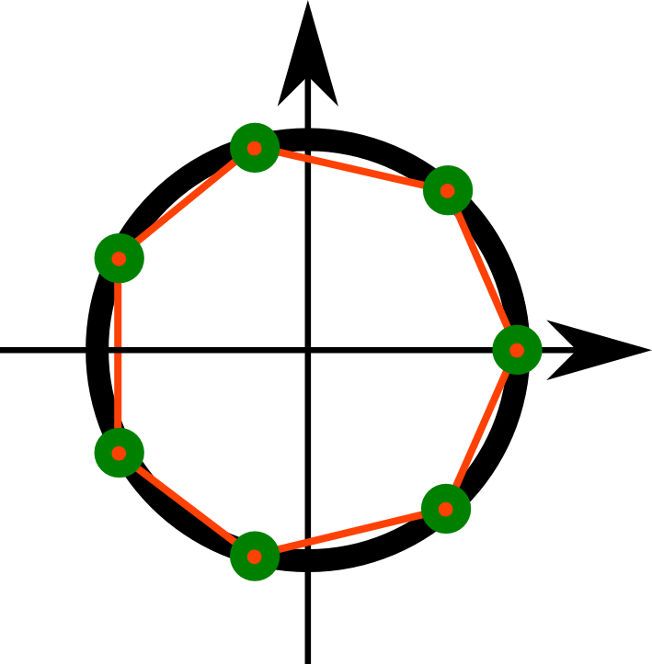
N=7

Slide 40
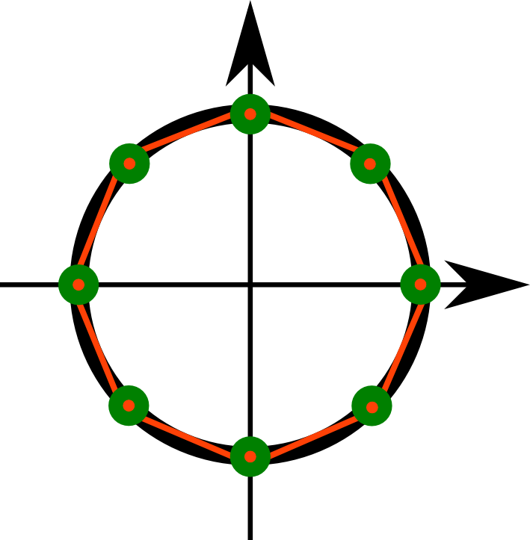
N=8

Slide 41
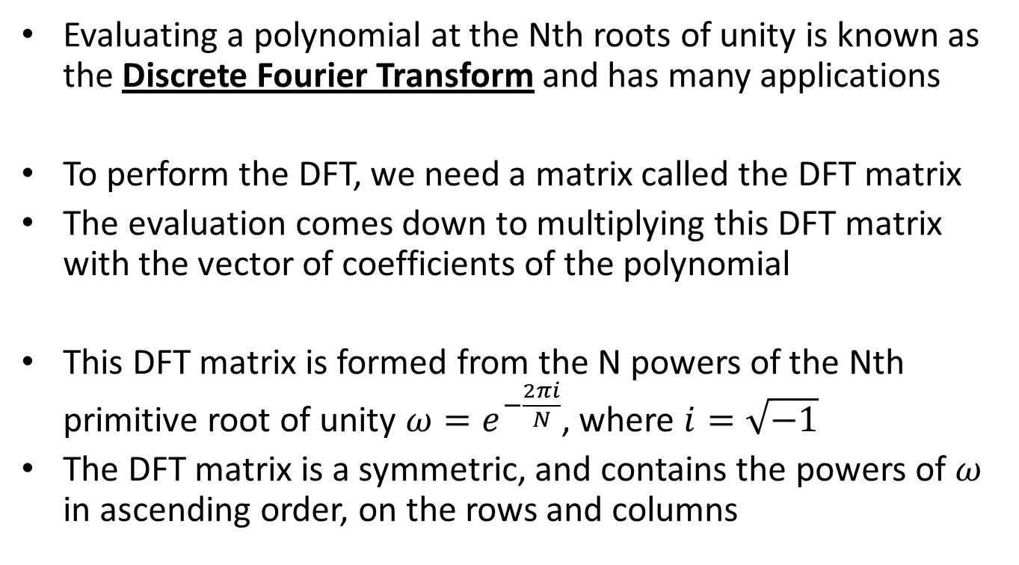
Evaluating a polynomial at the Nth roots of unity is known as the Discrete Fourier Transform and has many applications
To perform the DFT, we need a matrix called the DFT matrix
The evaluation comes down to multiplying this DFT matrix with the vector of coefficients of the polynomial
This DFT matrix is formed from the N powers of the Nth primitive root of unity $ω=e^{−\frac{2πi}{N}}$, where $i=\sqrt{−1}$
The DFT matrix is a symmetric, and contains the powers of $ω$ in ascending order, on the rows and columns

Slide 42
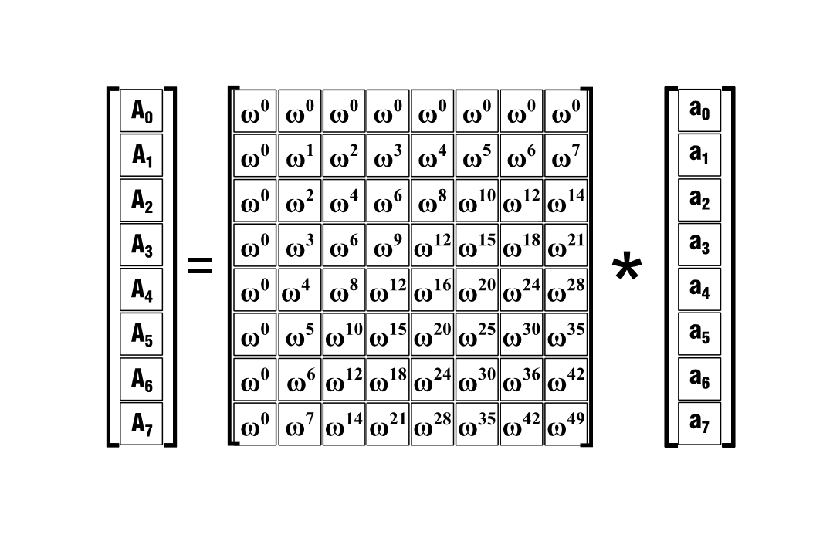
We can see the DFT matrix is a Vandermonde matrix of the Nth roots of unity

Slide 43
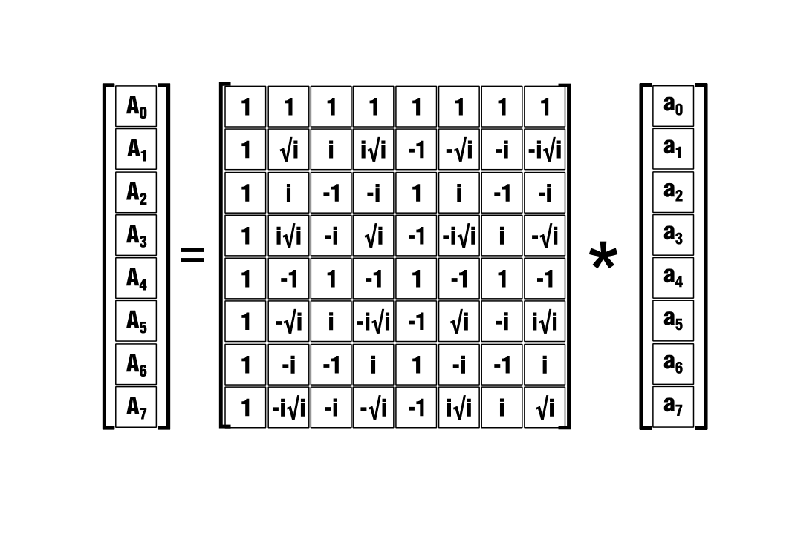
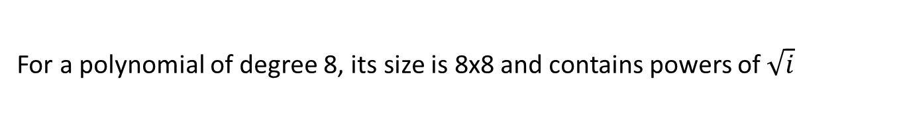
For a polynomial of degree 8, its size is 8x8 and contains powers of $\sqrt{i}$

Slide 44
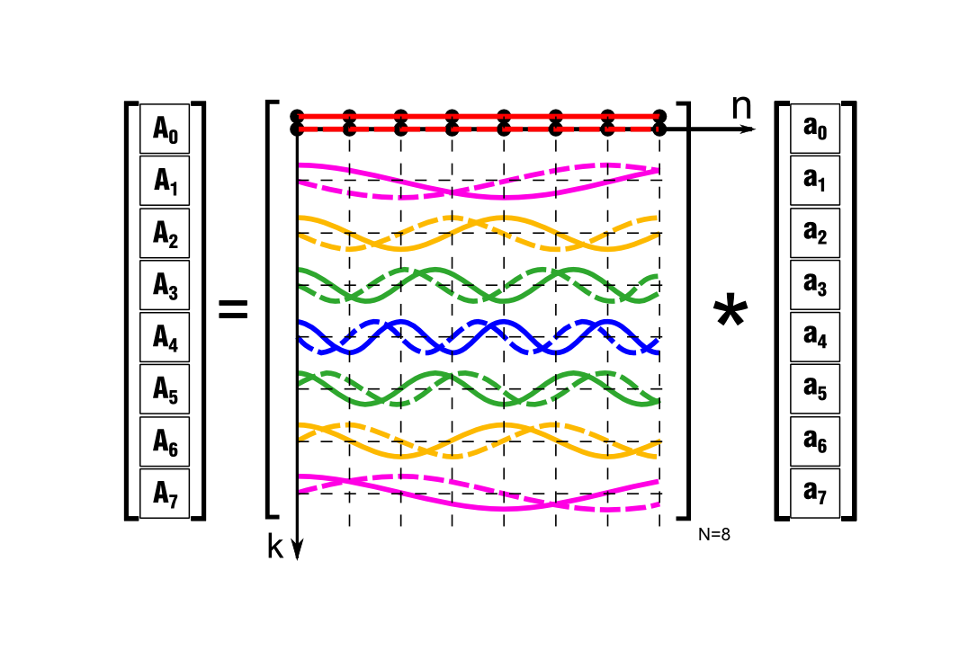
The rows of the DFT matrix correspond to basic harmonic waveforms They transform the seed vector in the spectral plane

Slide 45
This computation is nothing but a matrix-vector product

Slide 46
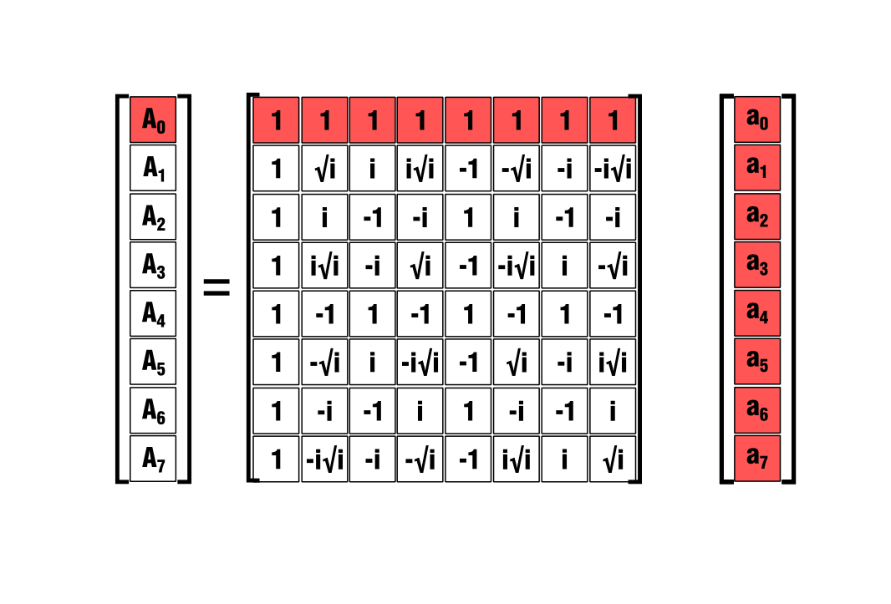
Each element of the result is equal to the inner product of the corresponding row of the matrix with the seed vector

Slide 47
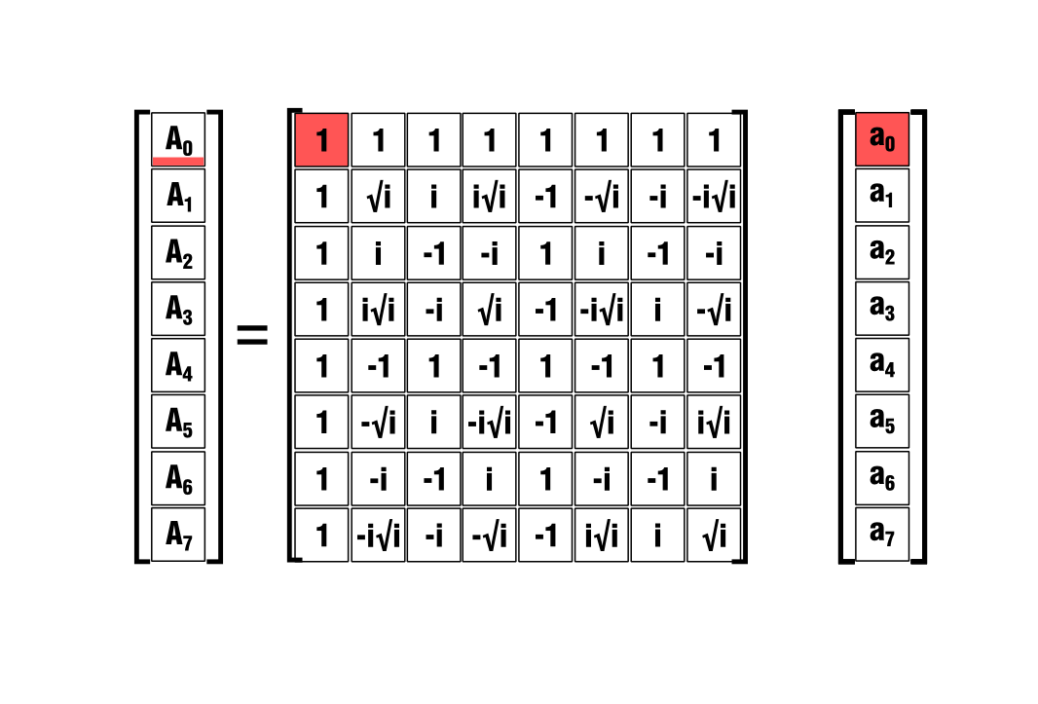
So we are dealing with 8 terms obtained from multiplications

Slide 48
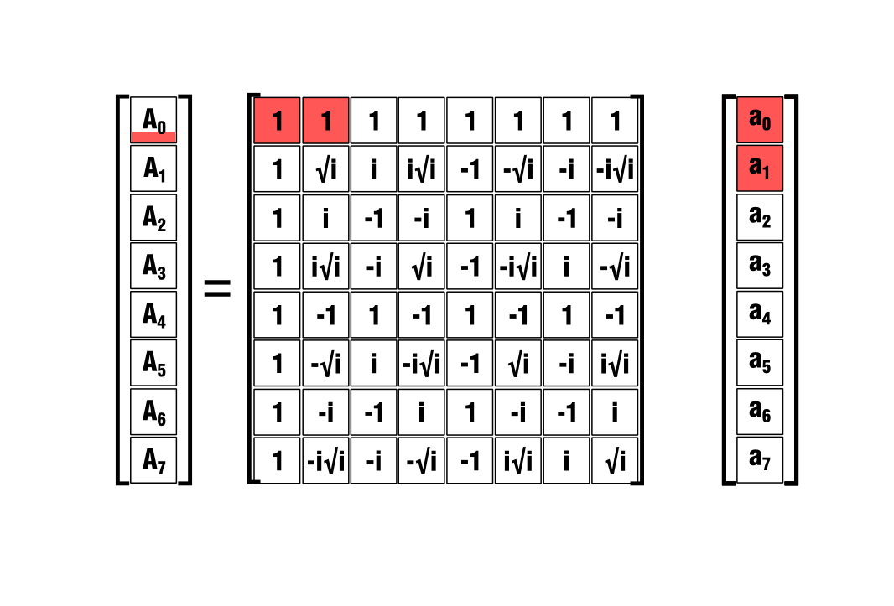
Adding these terms that come from multiplications

Slide 49
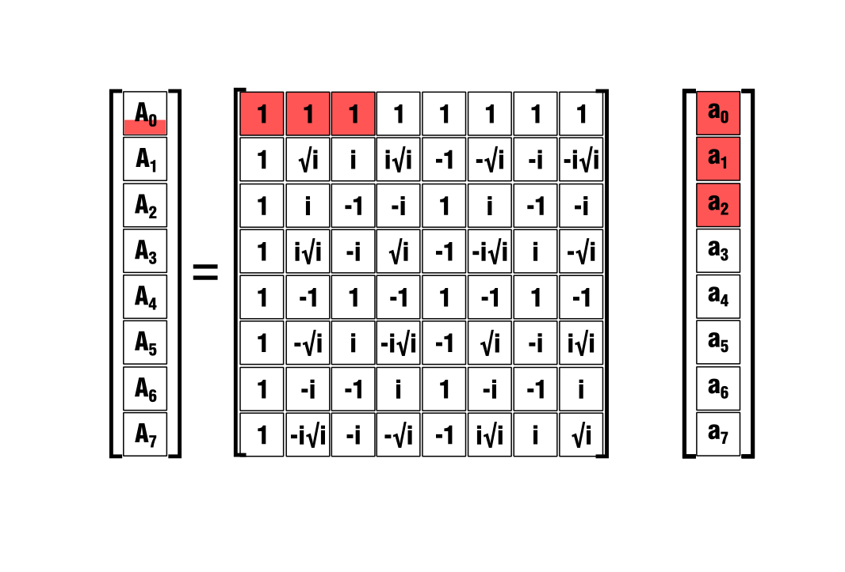
And, first and foremost, computing the elements of the DFT matrix..

Slide 50
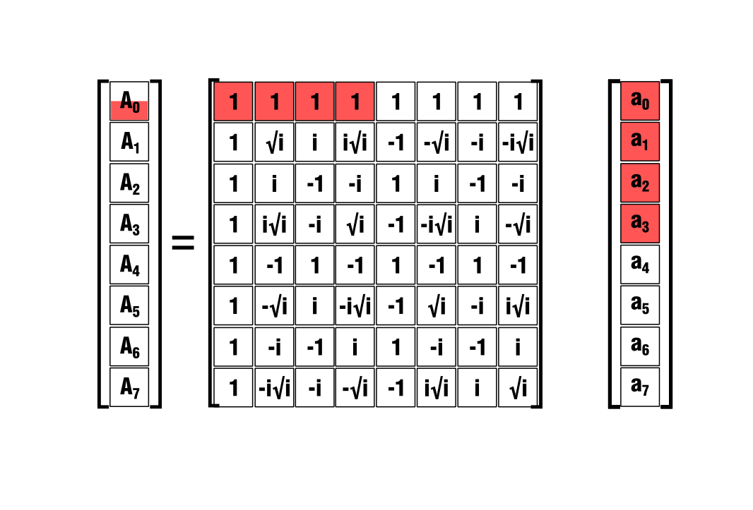
..for every pair of elements from the matrix and the vector

Slide 51

So the computational cost of this matvec is $O(n^{2})$

Slide 52
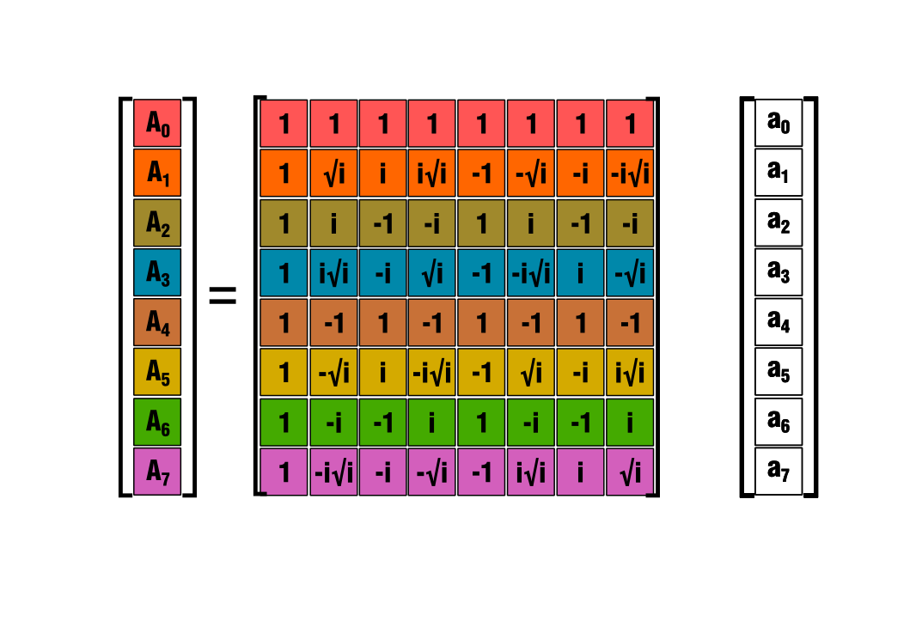
Because we have to do this for each row. Which might be take a while..

Slide 53

We can speed up the matvec using some nice properties of DFT This is the FFT algorithm (FAST Fourier Transform)

Slide 54


Obviously, we have $ω^{0}=1$

Slide 55


Since $N=8$ (degree of polynomial) then $ω^{8}=1$ and $ω^{4}=−1$

Slide 56


For any integer $k$, we have $ω^{8+k}=ω^{8}$, so $ω^{0}=ω^{8}=ω^{16}=ω^{24}=1$

Slide 57


At the same time, $ω^{4}=ω^{12}=ω^{20}=ω^{28}=ω^{36}=−1$

Slide 58


Another property is $ω^{4+k}=−ω^{k}$ Which can be confirmed from the elements already placed in the matrix

Slide 59


So when we compute $ω^{1}=\sqrt{i}$ From the first property, we have $ω^{9}=ω^{25}=ω^{49}=$ $\sqrt{i}$

Slide 60


And from the second property, $ω^{5}=ω^{21}=−\sqrt{i}$

Slide 61


Going further with this operation, when we compute $w^{2}=i$ We also get $ω^{10}=ω^{18}=ω^{42}=i$

Slide 62


And $ω^{6}=ω^{14}=ω^{30}=−i$

Slide 63


Finally, we have $ω^{3}=i\sqrt{i}$ so ${ ω}^{35}=i\sqrt{i}$

Slide 64


And also, $ω^{7}=ω^{15}=−i\sqrt{i}$

Slide 65
Only after 3-4 steps, we filled the DFT matrix completely

Slide 66
Fast Fourier Transform (FFT)
FFT is used to compute this matrix-vector product with a smaller number of computations.
It is a recursive strategy of divide-and-conquer.
FFT uses the observation made previously that we can express any polynomial as a sum between its terms in odd coefficients and those in even coefficients.
This operation can be repeated until we split the polynomial in linear polynomials that can be easily evaluated

Slide 67

FFT
procedure FFT ( a, A, N, $ω$ )
if N=1 then
A[0]=a[0]
else
for k=0 to (N/2) -1
even_a[k] = a[2k]
odd_a[k] = a[2k+1]
end
FFT ( even_a, even_A, N/2, $ω^{2}$ )
FFT ( odd_a, odd_A, N/2, $ω^{2}$ )
for k=0 to N-1
A[k] = even_a[k * mod (N/2)] + $ω^{k}$ * odd_A[k * mod (N/2)]
end
end
end procedure FFT

Slide 68

FFT
FFT transforms the vector of coefficients “a” into the vector “A”.
procedure FFT ( a, A, N, $ω$ )
if N=1 then
A[0]=a[0]
else
for k=0 to (N/2) -1
even_a[k] = a[2k]
odd_a[k] = a[2k+1]
end
FFT ( even_a, even_A, N/2, $ω^{2}$ )
FFT ( odd_a, odd_A, N/2, $ω^{2}$ )
for k=0 to N-1
A[k] = even_a[k * mod (N/2)] + $ω^{k}$ * odd_A[k * mod (N/2)]
end
end
end procedure FFT

Slide 69

FFT
procedure FFT ( a, A, N, $ω$ )
if N=1 then
A[0]=a[0]
else
for k=0 to (N/2) -1
even_a[k] = a[2k]
odd_a[k] = a[2k+1]
end
FFT ( even_a, even_A, N/2, $ω^{2}$ )
FFT ( odd_a, odd_A, N/2, $ω^{2}$ )
for k=0 to N-1
A[k] = even_a[k * mod (N/2)] + $ω^{k}$ * odd_A[k * mod (N/2)]
end
end
end procedure FFT
It starts by splitting the given vector of coefficients in two subvectors.
One contains the odd-order coefficients, and the other one contains those of even order.

Slide 70

FFT
procedure FFT ( a, A, N, $ω$ )
if N=1 then
A[0]=a[0]
else
for k=0 to (N/2) -1
even_a[k] = a[2k]
odd_a[k] = a[2k+1]
end
FFT ( even_a, even_A, N/2, $ω^{2}$ )
FFT ( odd_a, odd_A, N/2, $ω^{2}$ )
for k=0 to N-1
A[k] = even_a[k * mod (N/2)] + $ω^{k}$ * odd_A[k * mod (N/2)]
end
end
end procedure FFT
Then, it proceeds in a recursive fashion to split these vectors again

Slide 71

FFT
procedure FFT ( a, A, N, $ω$ )
if N=1 then
A[0]=a[0]
else
for k=0 to (N/2) -1
even_a[k] = a[2k]
odd_a[k] = a[2k+1]
end
FFT ( even_a, even_A, N/2, $ω^{2}$ )
FFT ( odd_a, odd_A, N/2, $ω^{2}$ )
for k=0 to N-1
A[k] = even_a[k * mod (N/2)] + $ω^{k}$ * odd_A[k * mod (N/2)]
end
end
end procedure FFT
This recursion stops when we reach subvectors of degree 1

Slide 72

FFT
procedure FFT ( a, A, N, $ω$ )
if N=1 then
A[0]=a[0]
else
for k=0 to (N/2) -1
even_a[k] = a[2k]
odd_a[k] = a[2k+1]
end
FFT ( even_a, even_A, N/2, $ω^{2}$ )
FFT ( odd_a, odd_A, N/2, $ω^{2}$ )
for k=0 to N-1
A[k] = even_a[k * mod (N/2)] + $ω^{k}$ * odd_A[k * mod (N/2)]
end
end
end procedure FFT
The actual computation is performed when the algorithm starts to exit the recursion.

Slide 73
FFT
procedure FFT ( a, A, N, $ω$ )
if N=1 then
A[0]=a[0]
else
for k=0 to (N/2) -1
even_a[k] = a[2k]
odd_a[k] = a[2k+1]
end
FFT ( even_a, even_A, N/2, $ω^{2}$ )
FFT ( odd_a, odd_A, N/2, $ω^{2}$ )
for k=0 to N-1
A[k] = even_a[k * mod (N/2)] + $ω^{k}$ * odd_A[k * mod (N/2)]
end
end
end procedure FFT
At each step backward, the output coefficients are updated.

Slide 74
FFT
procedure FFT ( a, A, N, $ω$ )
if N=1 then
A[0]=a[0]
else
for k=0 to (N/2) -1
even_a[k] = a[2k]
odd_a[k] = a[2k+1]
end
FFT ( even_a, even_A, N/2, $ω^{2}$ )
FFT ( odd_a, odd_A, N/2, $ω^{2}$ )
for k=0 to N-1
A[k] = even_a[k * mod (N/2)] + $ω^{k}$ * odd_A[k * mod (N/2)]
end
end
end procedure FFT
It evaluates polynomials from the

Slide 75

Let’s follow the algorithm step-by-step on the DFT matrix-vector product.

Slide 76

We pass the vector of coefficients to FFT which starts the recursion

Slide 77

First, it splits the 8 coefficients in 2 sets (odd and even)

Slide 78
It follows the recursion down one step for the first set of coefficients.

Slide 79

FFT splits this vector too and the recursion goes down one more step.

Slide 80

At the third split (log 8 = 3), FFT is passed a linear polynomial and returns.

Slide 81



FFT reached a polynomial of order 1, so it will evaluate it.
$$k=0$$
$$ω=1$$
$$ω^{k}=1$$

Slide 82

The first coefficient of A gets updated with this value.
$$k=0$$
$$ω=1$$
$$ω^{k}=1$$

Slide 83



Then, FFT evaluates the polynomial at the negative of the previous root.
$$k=1$$
$$ω=−1$$
$$ω^{k}=−1$$

Slide 84

The corresponding coefficient is updated with this value.
$$k=1$$
$$ω=−1$$
$$ω^{k}=−1$$

Slide 85

By computing these two values, FFT already computed the pairs for the other 3 polynomials.

Slide 86

We now exit the FFT for this polynomial (RED) and enter the branch of the recursion corresponding to the next polynomial

Slide 87



Again, we evaluate the two values.
$$k=0$$
$$ω=−1$$
$$ω^{k}=1$$

Slide 88


And update the corresponding coefficients.
$$k=1$$
$$ω=−1$$
$$ω^{k}=−1$$

Slide 89


Looking at the corresponding columns, we can see that the other values are computed, but can be used only when the other polynomials are active, and when FFT evaluates at the right power of the primitive root of unity
$$k=0$$
$$ω=−i$$
$$ω^{k}=1$$

Slide 90



After exiting the recursion to the second level, we can update the output coefficients by interchanging the values computed already.
$$k=1$$
$$ω=−i$$
$$ω^{k}=i$$

Slide 91



$$k=1$$
$$ω=−i$$
$$ω^{k}=i$$

Slide 92


$$k=0$$
$$ω=−i$$
$$ω^{k}=1$$

Slide 93

FFT exits the recursion to the higher level and works on the second half.

Slide 94

FFT evaluates these basic polynomials too, and updates the coefficients.

Slide 95


Slide 96


Slide 97


Slide 98

After evaluating the last linear polynomial, FFT has computed all the values it needs. From now on, the computation will rely on combining these values.

Slide 99

Exiting the recursion, the coefficients are, again, updated at each step.

Slide 100


Slide 101


Slide 102


Slide 103


Slide 104

Finally, FFT goes back to the upper level and combines the subpolynomials.

Slide 105

At this level, we can see the strength of FFT.

Slide 106

It combines larger subpolynomials, so the computation is being sped up exponentially with each level.

Slide 107


Slide 108


Slide 109


Slide 110


Slide 111

With FFT, after three levels of recursion, we computed the matvec product.

Slide 112


Slide 113
Multiplying the polynomials
In order to compute the product-polynomial, we will have to evaluate the two polynomials at enough points (2n-1) and multiply them element-wise
These products correspond to the spectral coefficients of the product.
In order to obtain its explicit form, we have to interpolate these values. This is done with the inverse DFT matrix, which contains the inverse of the DFT matrix, taken element-wise.
We can employ the same FFT algorithm to compute this fast.

